Slide 1



DC Water Asset Management
Project – 4
And
Final
Presentation
April 22, 2024
Erin Cooper
Eyasu Yilma

Slide 2

Predicting Risk on Critical DC Water Asset and
Determine Cost Impact on various User Jurisdictions

Slide 3
Project Workflow Chart
SQL
Flow per user
Python Pandas
Data Import
(IBM Maximo & DC Water Report
Flow
and cost analysis
User Cost Share
Cost Impact of Collapse
SQL
Labor Hour Per Location
Tableau
Leaflet
Visualization
Location Description
ML
ML
ML
Pipe Condition
Inspection cycle
Predict
Risk per location

Slide 4
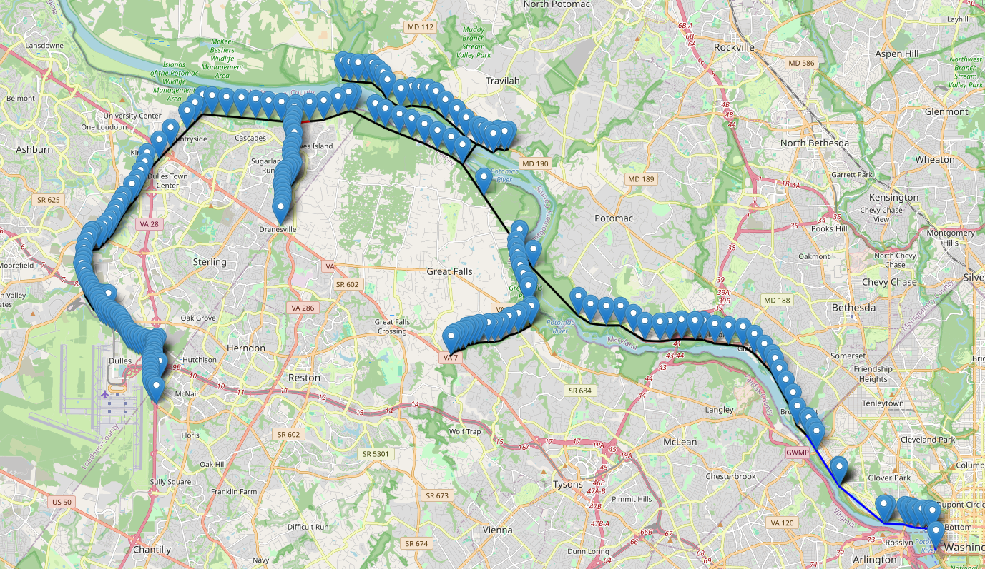
DC Water Asset, The Potomac Interceptor, Serves 1.6 million, 55 mgd, 50 mile long
Notes:
We began by creating

Slide 5
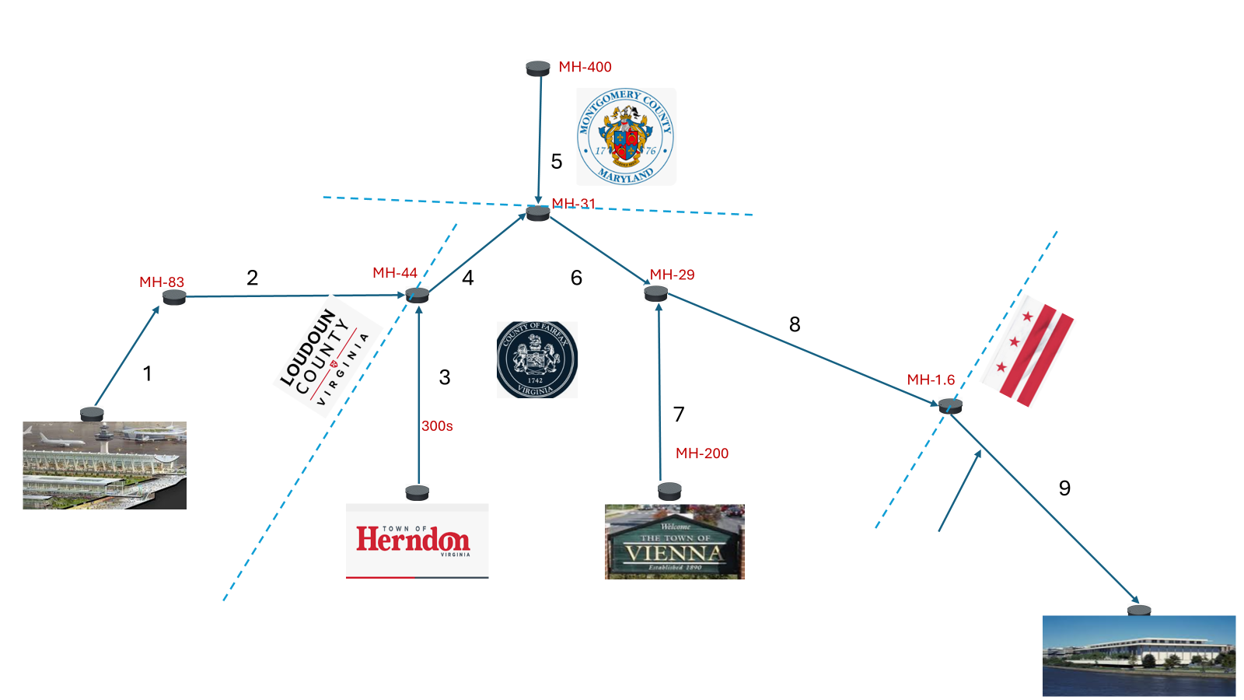

Slide 6

Risk Prediction
Using
Supervised Machine Learning

Slide 7
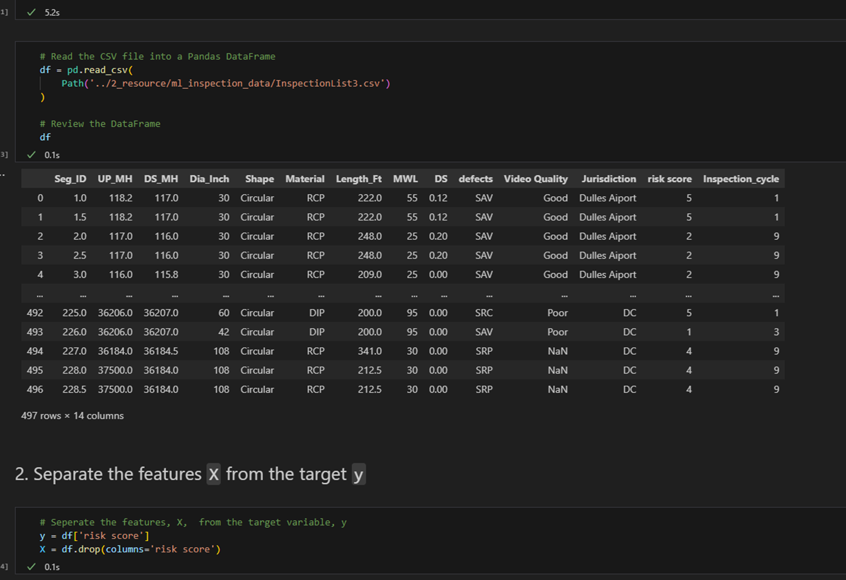
Reading CSV File
Data Import
Target & Feature
Separation

Slide 8
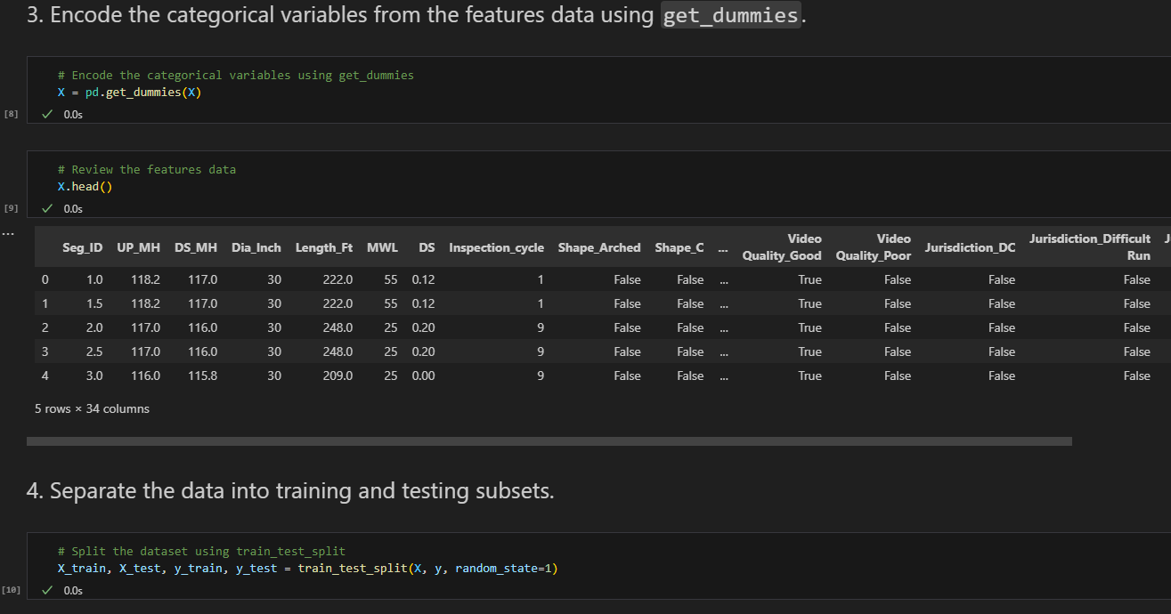
Encode the categorical variables using get_dummies
Get dummies
Separate Data
Training & Testing Subset

Slide 9
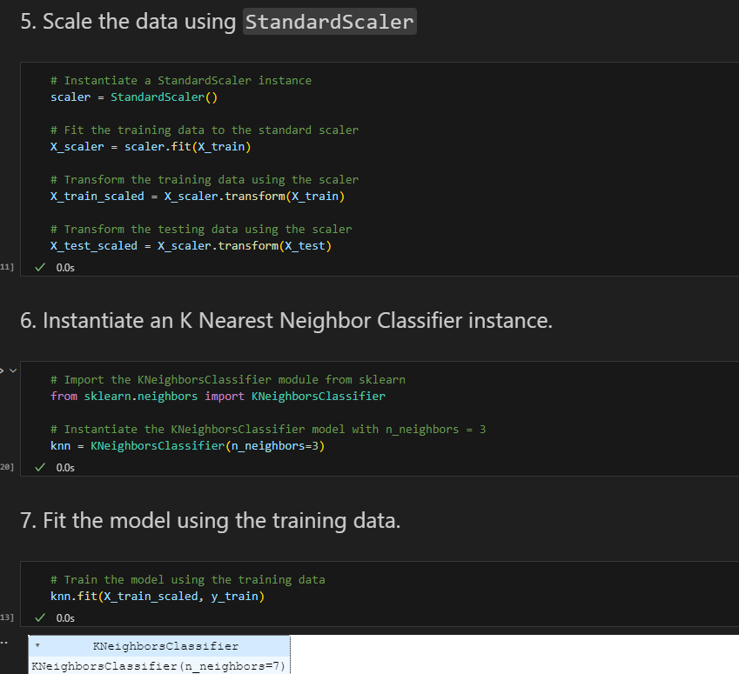
Scale the & Sklearn
Scale data
Instantiate Classifier Instance
Fit the Model with Training data

Slide 10
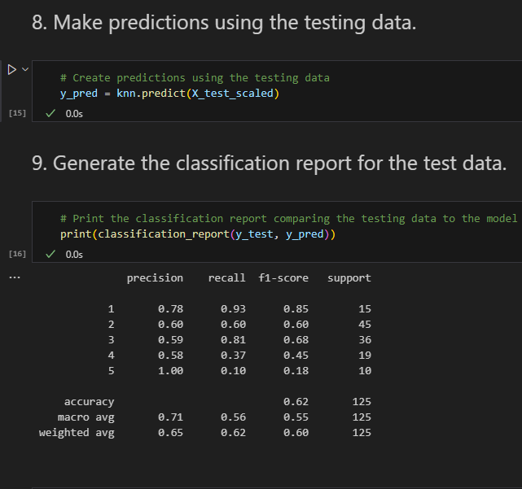
Make Prediction

Slide 11
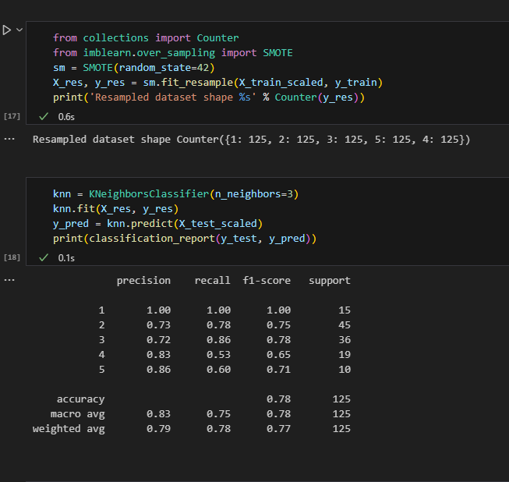
Resampled Dataset

Slide 12
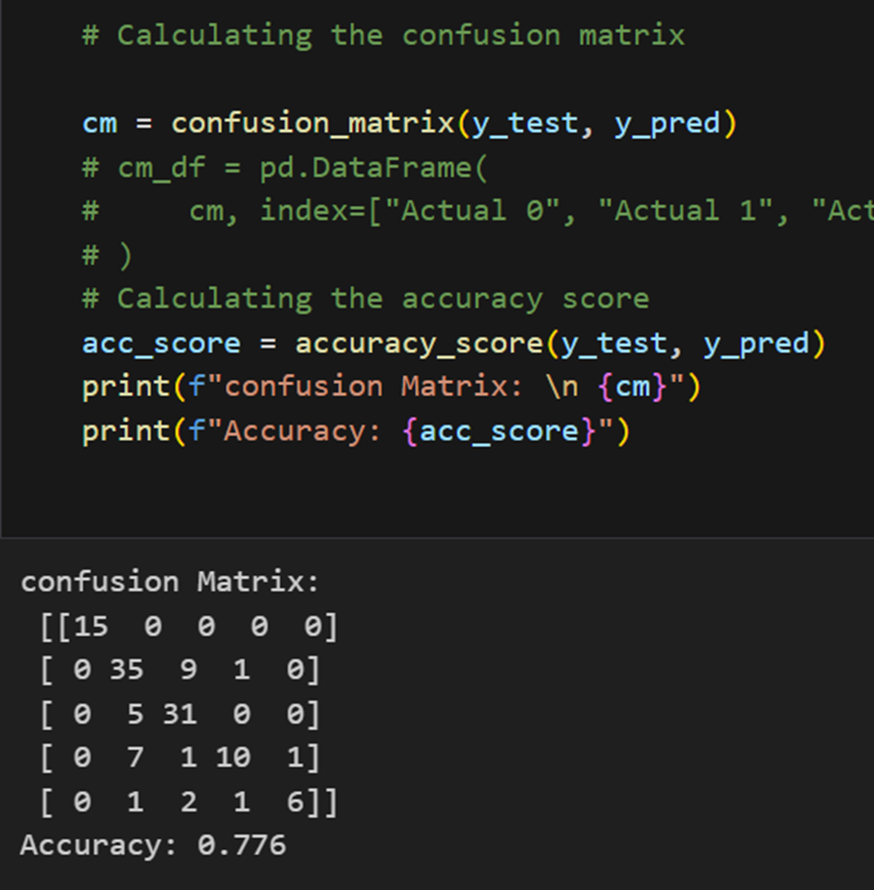
Confusion Matrix

Slide 13

Flow Share Calculation
Using
SQL
Python Pandas

Slide 14

Data Acquisition
Maximo - Labor hours per Job number
User Jurisdiction - Flow Report
DC Water - Asset Database
Consultant/Contractor Report - Pipe Inspection data

Slide 15
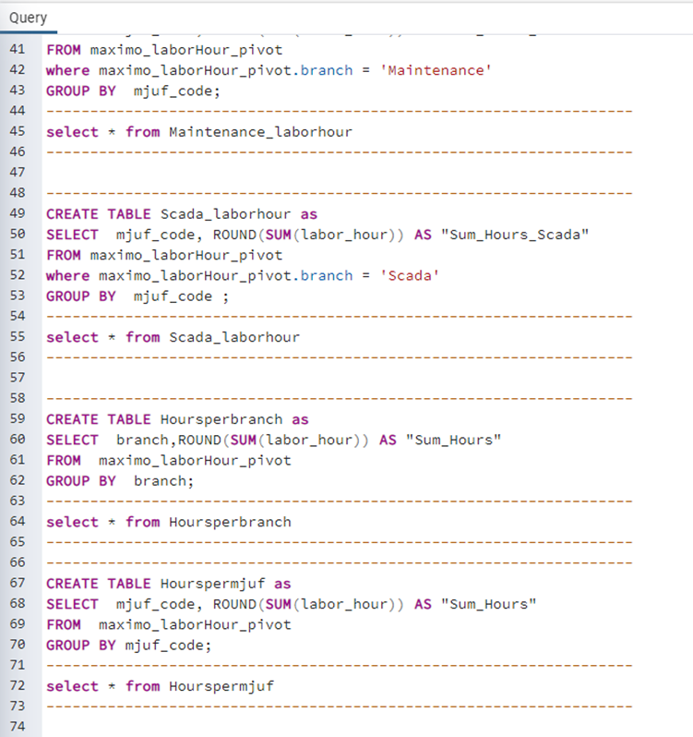
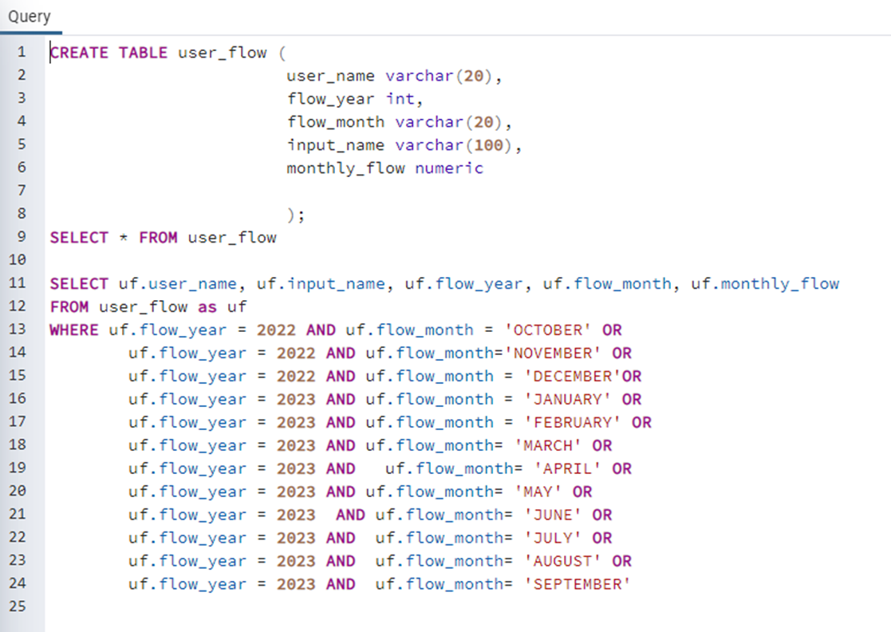
Data Preprocess and Filtering
Upload in SQL
Join using location Id
Download CSV
Import Python Pandas

Slide 16
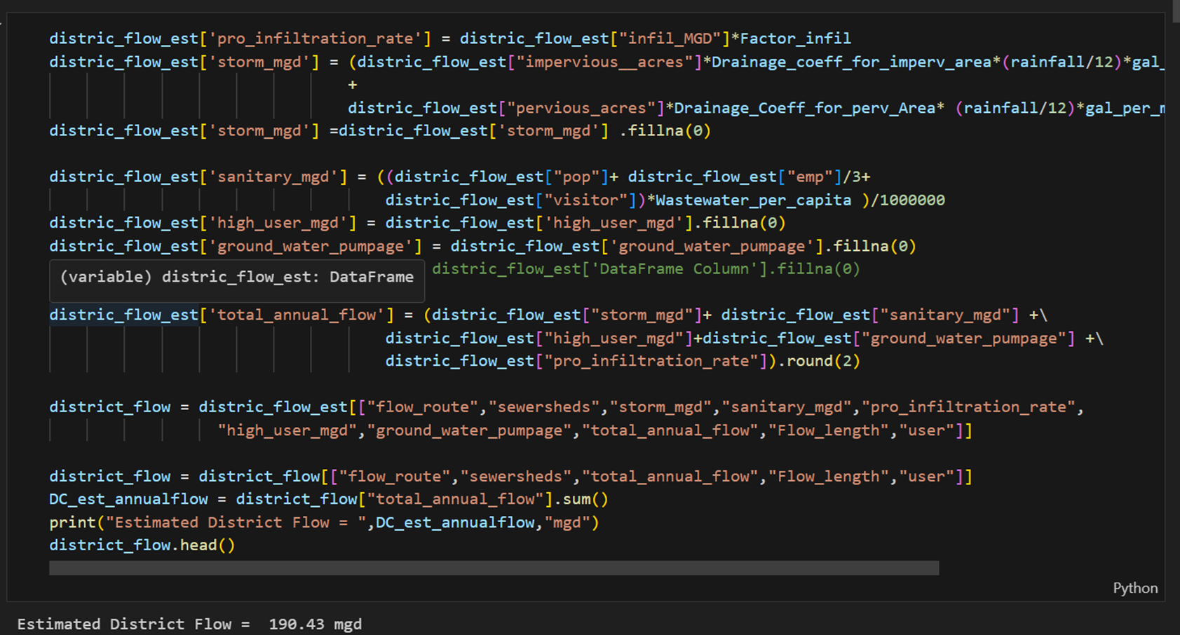

District Flow

Slide 17
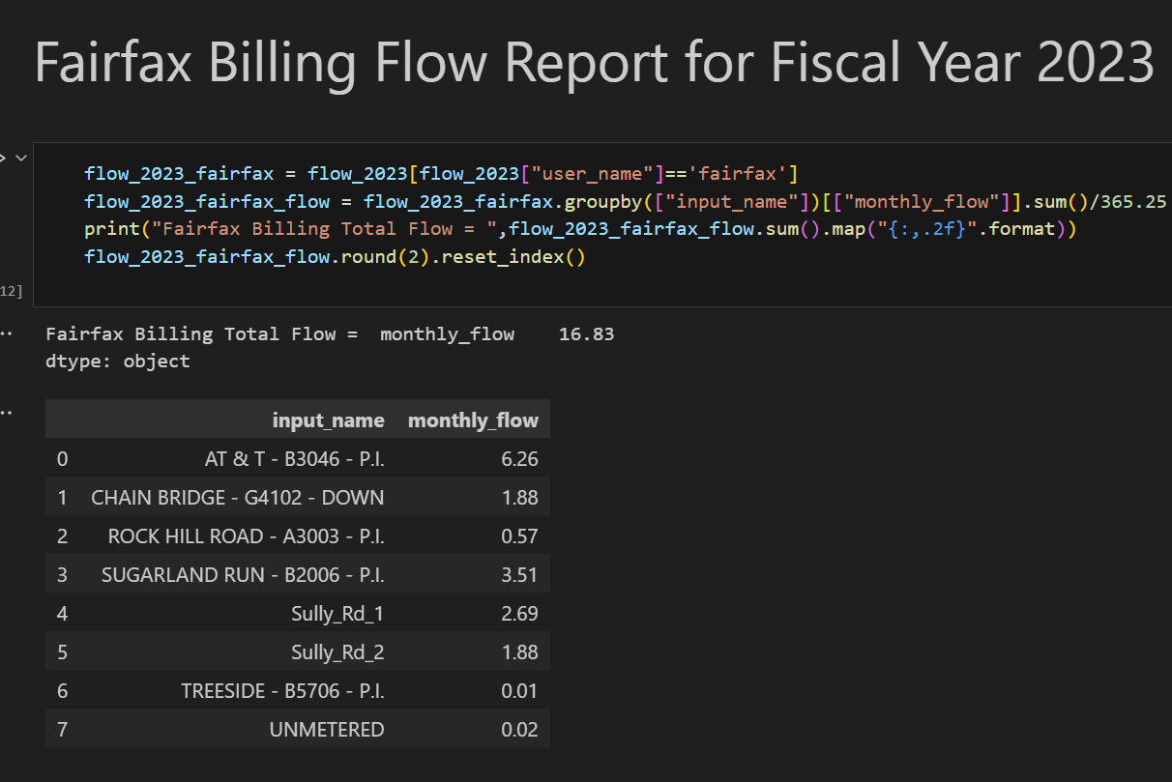

Suburban User

Slide 18
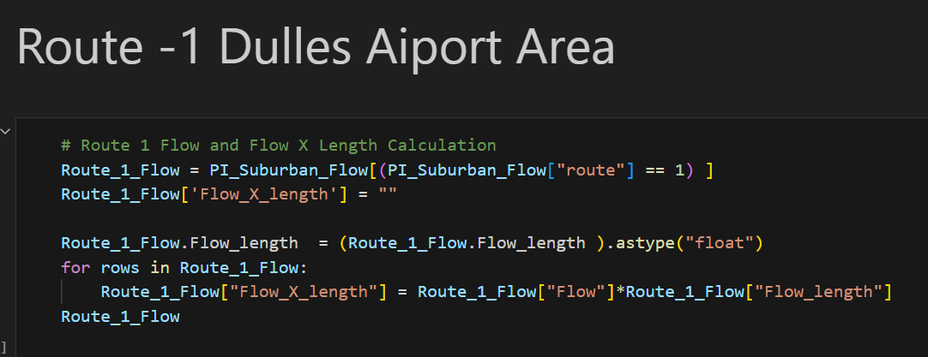

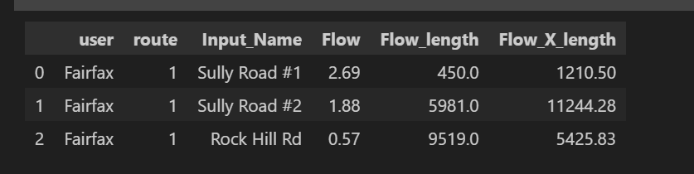
Flow Share Cont’s

Slide 19
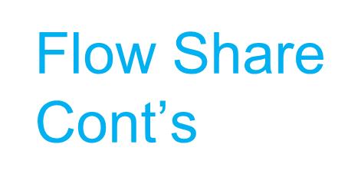
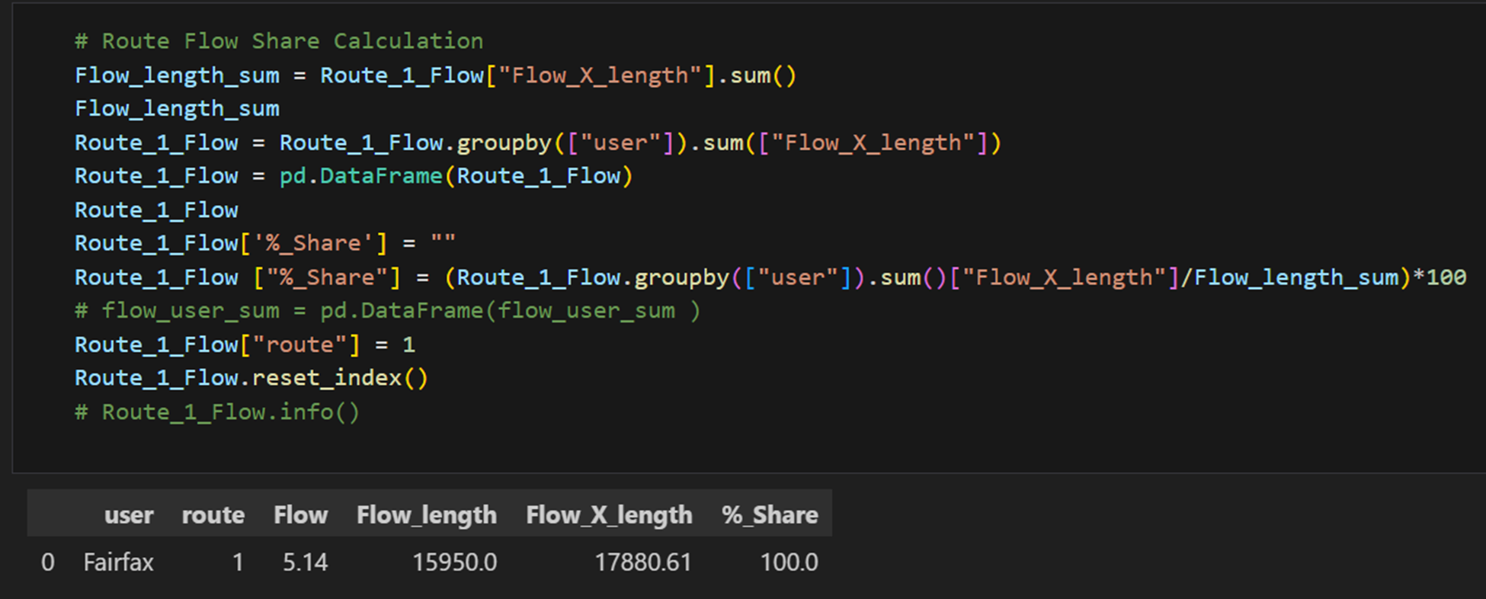

Slide 20
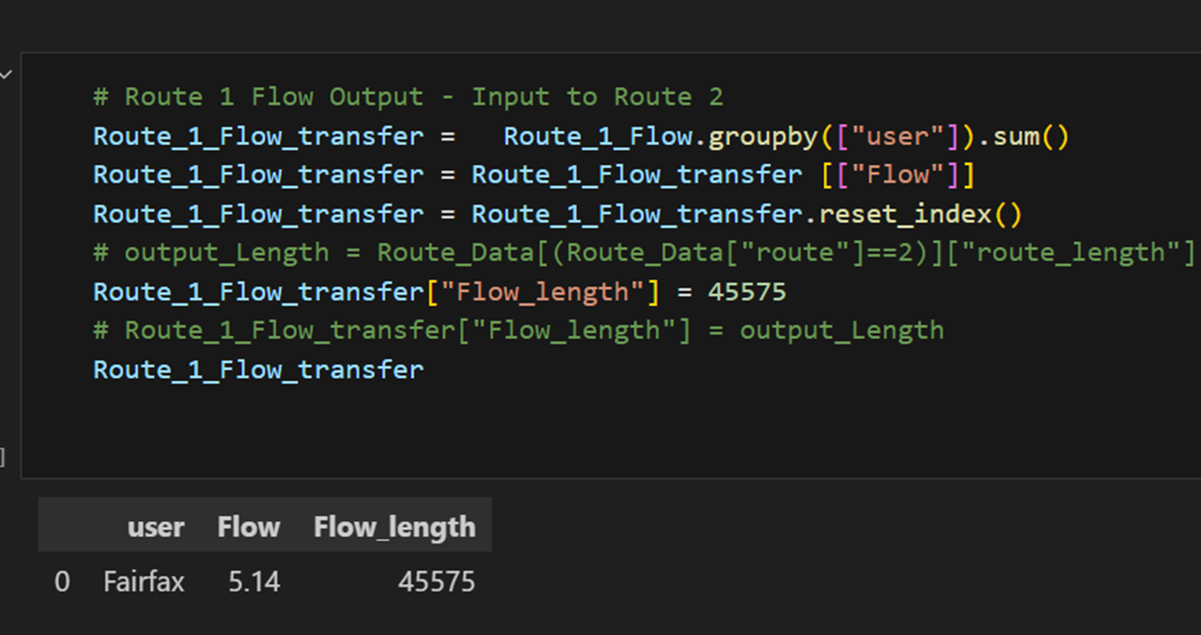

Slide 22
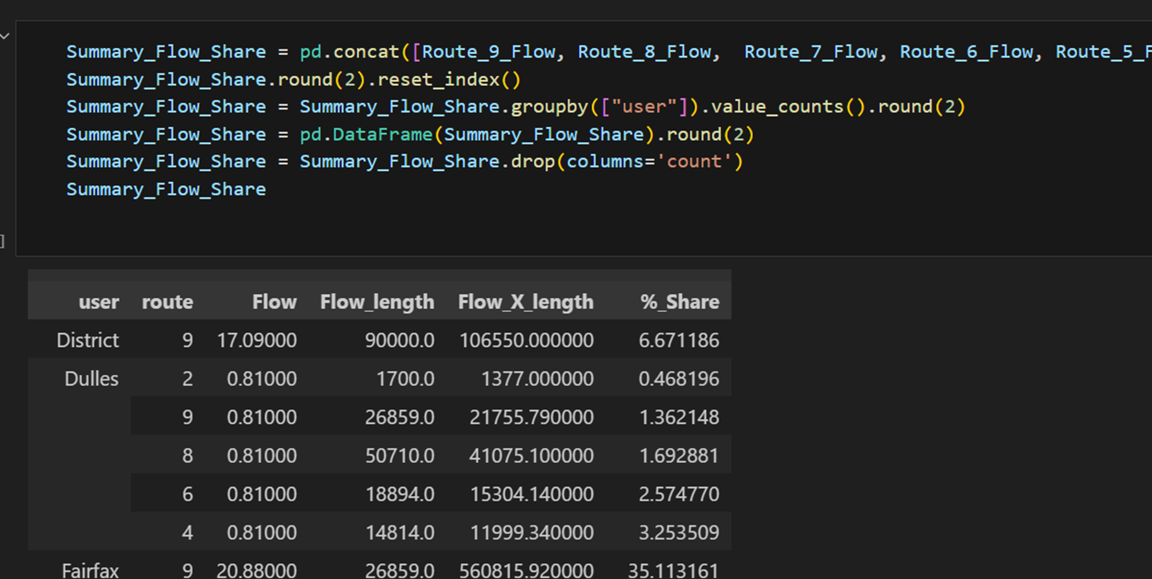

Slide 23

Output and Visualization with Tableau

Slide 24
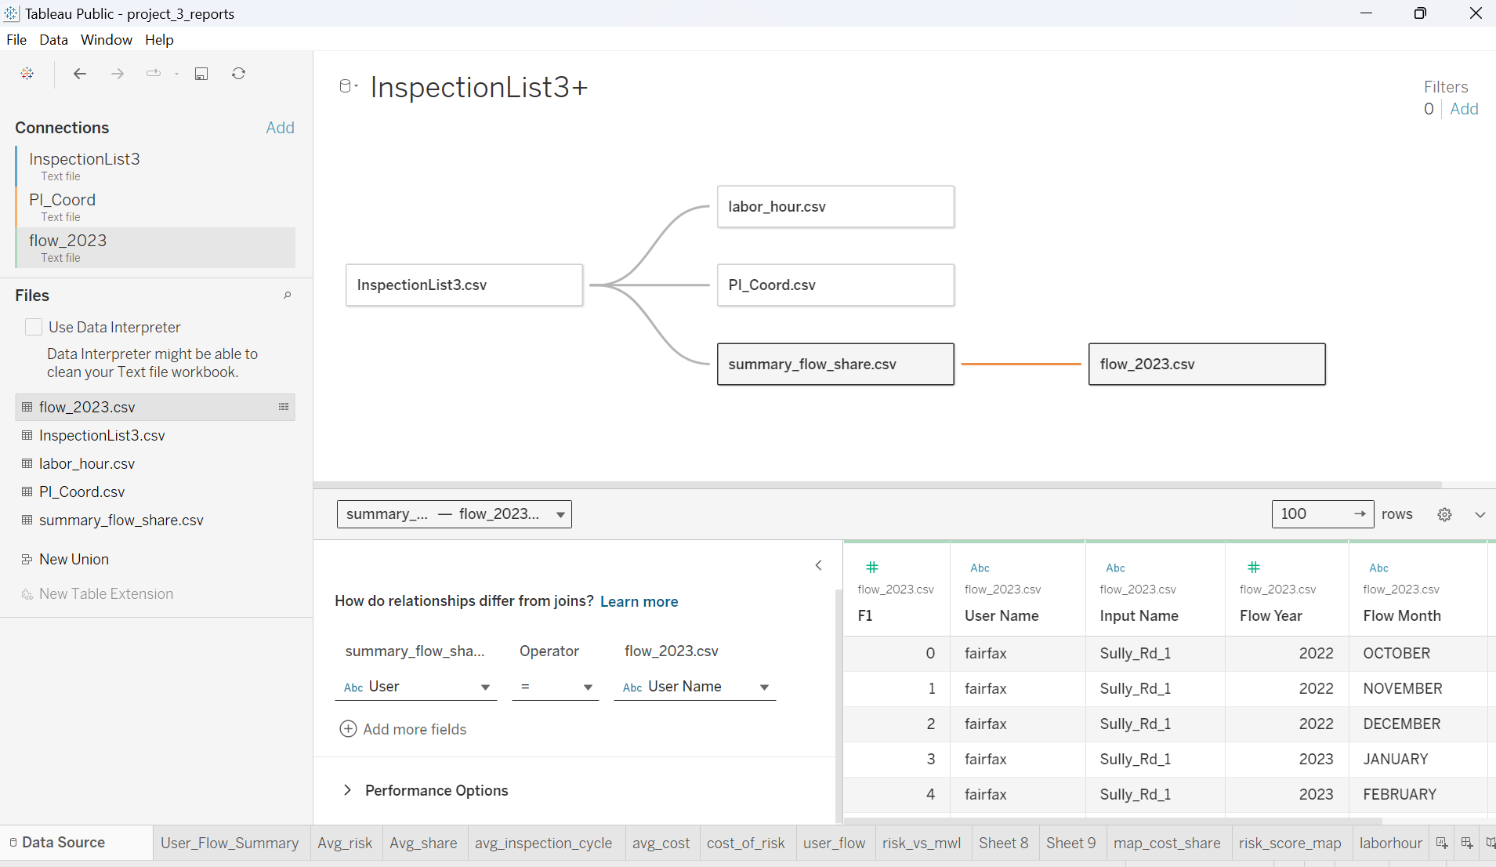
Output and Visualisation

Slide 25
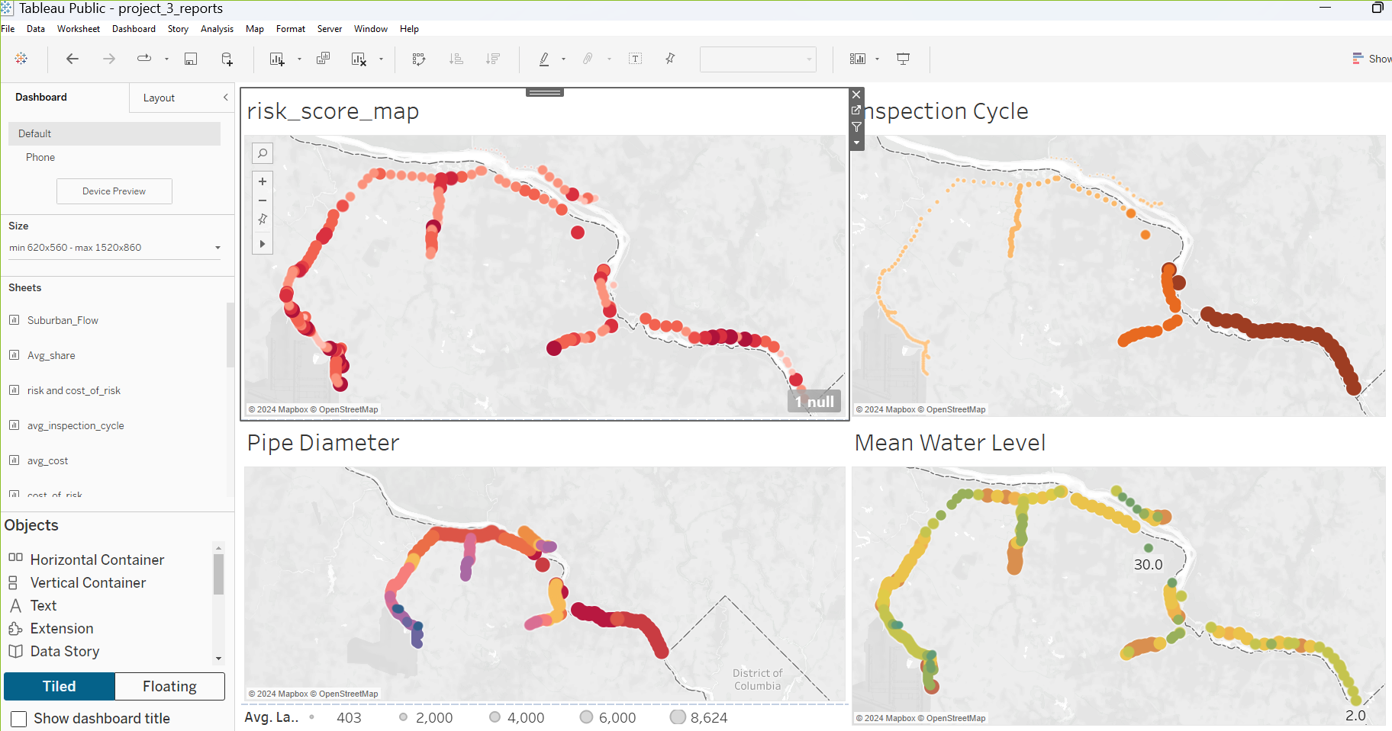

Slide 26
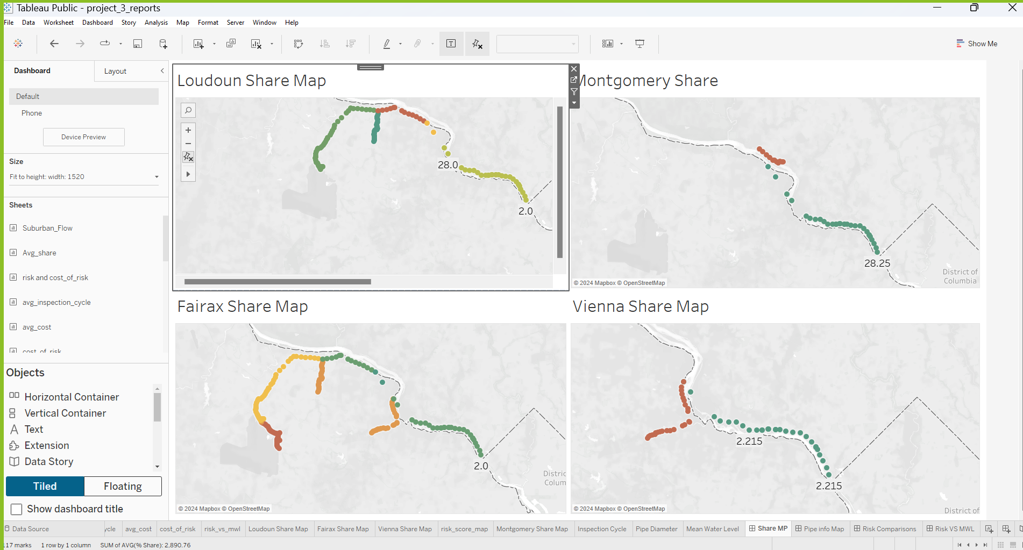

Slide 27
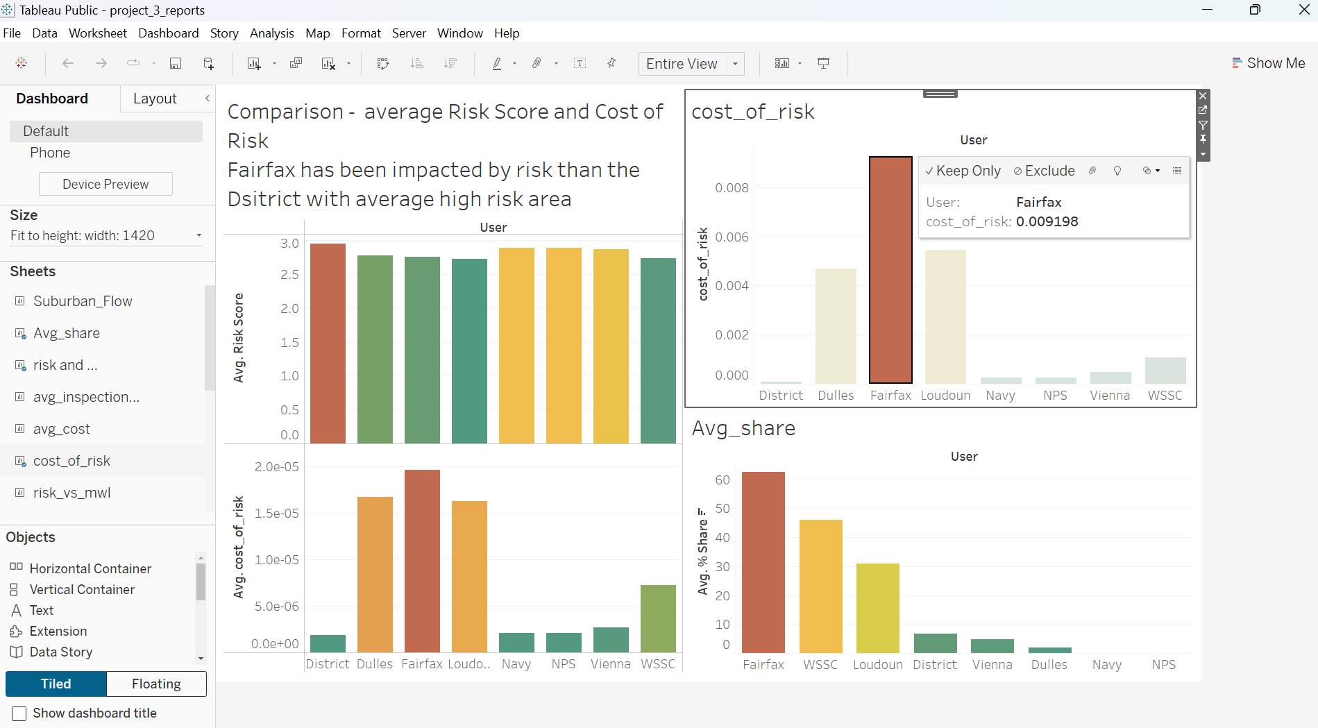

Slide 28
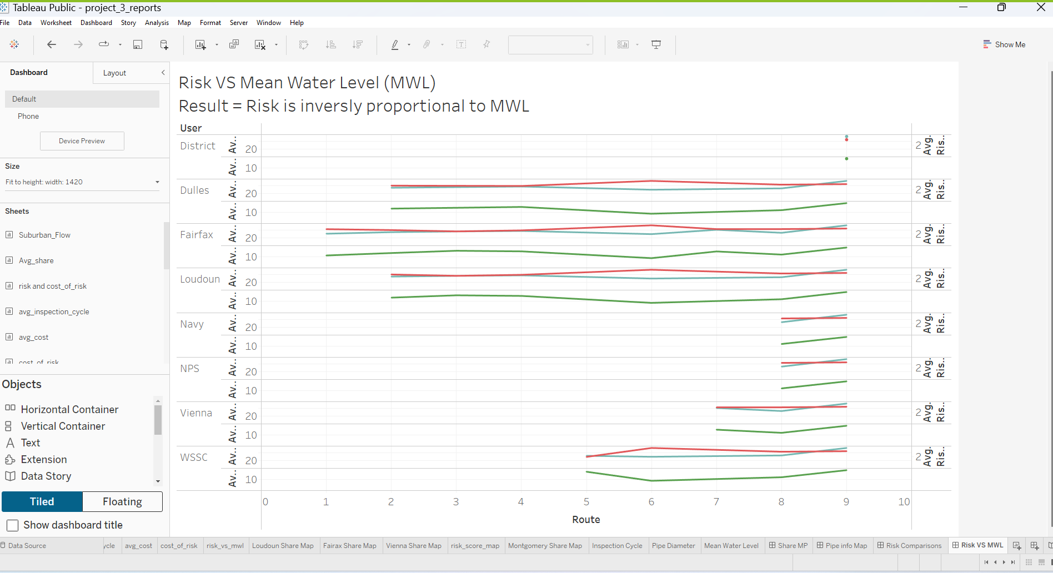

Slide 29


Thank You !

